Slide 1
Documenting Your Software
David E. Bernholdt (he/him) Oak Ridge National Laboratory
Better Scientific Software tutorial @ NOAA Global Systems Laboratory
Contributors: David E. Bernholdt (ORNL), Anshu Dubey (ANL), Miranda Mundt (SNL)

Slide 2

License, Citation and Acknowledgements
License and Citation
This work is licensed under a Creative Commons Attribution 4.0 International License (CC BY 4.0).
The requested citation the overall tutorial is: David E. Bernholdt, Anshu Dubey, and Patricia A. Grubel, Better Scientific Software tutorial, in NOAA Global Systems Laboratory, Boulder, Colorado, 2023. DOI: 10.6084/m9.figshare.23796606.
Individual modules may be cited as Speaker, Module Title, in Tutorial Title, …
Acknowledgements
This work was supported by the U.S. Department of Energy Office of Science, Office of Advanced Scientific Computing Research (ASCR), and by the Exascale Computing Project (17-SC-20-SC), a collaborative effort of the U.S. Department of Energy Office of Science and the National Nuclear Security Administration.
This work was performed in part at the Argonne National Laboratory, which is managed by UChicago Argonne, LLC for the U.S. Department of Energy under Contract No. DE-AC02-06CH11357.
This work was performed in part at the Lawrence Livermore National Laboratory, which is managed by Lawrence Livermore National Security, LLC for the U.S. Department of Energy under Contract No. DE-AC52-07NA27344.
This work was performed in part at the Los Alamos National Laboratory, which is managed by Triad National Security, LLC for the U.S. Department of Energy under Contract No.89233218CNA000001
This work was performed in part at the Oak Ridge National Laboratory, which is managed by UT-Battelle, LLC for the U.S. Department of Energy under Contract No. DE-AC05-00OR22725.
This work was performed in part at Sandia National Laboratories. Sandia National Laboratories is a multi-mission laboratory managed and operated by National Technology and Engineering Solutions of Sandia, LLC., a wholly owned subsidiary of Honeywell International, Inc., for the U.S. Department of Energy’s National Nuclear Security Administration under contract DE-NA0003525.

Slide 3
Documentation Overview
Software documentation is any artifact made as part of the software development process that is intended to communicate information about the software system about which it was written.
Most people are familiar with this concept and know good documentation when they see it. More difficult, however, is how to write good documentation.

Slide 4
Benefits of Good Documentation
Better Maintainability
Undocumented or incorrectly documented code can do more harm than good
It is difficult to maintain code that does not have sufficient and accurate documentation
Good documentation clarifies what the code is doing in each part and makes it easier to change
Improved Team Productivity
Especially for new team members, sufficiently good documentation can help get everyone on the same page and new members up to speed
Increased Code Quality
Documenting what you think your code does helps to clear up inconsistencies and can lead developers to refactor something that is needlessly complicated
Overall, documentation has a positive effect on overall quality

Slide 5
The Challenges to Making Good Documentation
Time: Writing good documentation can take time, and especially for projects with unreliable or limited funding, it can become an afterthought. It also introduces potential technical debt if interfaces or functionality change.
Skill: Writing good documentation is hard. It must be practiced and practiced and practiced. People can become jaded by how much practice it takes to become truly skilled at documenting well.
Process: Does writing documentation feel unnatural or “clunky” to you? Without proper processes, writing documentation can feel like it’s wasting your precious time.

Slide 6
Some Documentation Types by their Primary Audience
Maintainers, Developers, Outside Contributors
Users
Requirements analysis
Design and architecture
Contributor’s guide
Information to help a new developer or outside contributor do things the way the maintainers want them done
Coding standards
Automate what can be checked/enforced mechanically
Document all the standards that are important (noting what is automatically enforced)
In-code documentation (why, not what)
APIs
Automated tools can provide skeletons for API documentation, but humans need to add important content
Reference manual
Installation guide
If users can’t build and install your software easily, they’re likely to give up and try an alternative rather than figuring out problems
Good to provide simple tests/examples so user can verify working installation
User guide
Debugging and troubleshooting help is useful
Tutorials and examples
If you provide example inputs, include the corresponding outputs!
APIs (for libraries)
Reference manual (for libraries)

Slide 7
Software Lifecycle
Integration of New Research
Initial Development
Requirements analysis
Design
Capability
Addition
Verification validation
Implementation
Maintenance
Ongoing Testing
Issues and Bug Resolution
Release
Distribution
User Support

Slide 8
Stages
Initial Development
Requirements analysis
Expectations from the software
Capabilities needed
Solvers needed
Constraints
How will they be tested
Example
Same code for different applications -> configurability
Needed capabilities
Battery of tests

Slide 9
Stages
Initial Development
Design
Software overview
Architecture
Interfaces
Coding principles
Coding standards
Example
Design docs → snapshot of discussion
Online example of components
Coding standards

Slide 10
Stages
Initial Development
Header – documenting functionality, inputs and outputs and outcomes
API – tools that autogenerate documentation
Doxygen, NDoc, Visual Expert, Javadoc, EiffelStudio, Sandcastle, ROBODoc, POD, TwinText
Inline documentation
Implementation choices
Implementation

Slide 11
Stages
User’s guide
Developer’s guide
Reference manual
API
Online reference
Maintenance
Ongoing Testing
Issues and Bug Resolution
Release
Distribution
User Support

Slide 12
Ongoing Development and Maintenance
Integration of New Research
Initial Development
User’s guide
Deveoper’s guide
Reference manual
Requirements gathering
Design
Capability
Addition
API
Verification validation
Implementation
Maintenance
Ongoing Testing
Issues and Bug Resolution
Release
Distribution
User Support

Slide 13
Better Practices for Documentation
Version control your documentation
Preferably in the same repo as the code
Good enough is better than perfect
There’s always room for improvement, but it is better to have something than nothing
Don’t write more documentation than you can maintain
Voluminous documentation means more to maintain as the code evolves
Know your audience
Document as you go, while it is fresh in your mind
User test your documentation

Slide 14
Meet Your Readers Where They’re At
When writing documentation, put yourself in the mindset of your reader
Consider…
Culture: you have understandings, language (e.g., slang), etc., that are a product of the culture in which you’ve developed. Readers from other cultural backgrounds may not share them
Context: different scientific domains often use technical terms differently. It can be hard to recognize when this is happening – listen carefully for indications
Experience: readers may have different levels and types of experience from you
Recall the common exercise of writing instructions for making a peanut butter and jelly sandwich
Consider developing and utilizing a few personas for your audience(s) to help ground thinking
Whenever possible, test documentation with exemplars from your audience(s)
Good opportunities include: on-boarding of new developers, tutorials for users, etc.
Questions you receive may reflect gaps in documentation

Slide 15
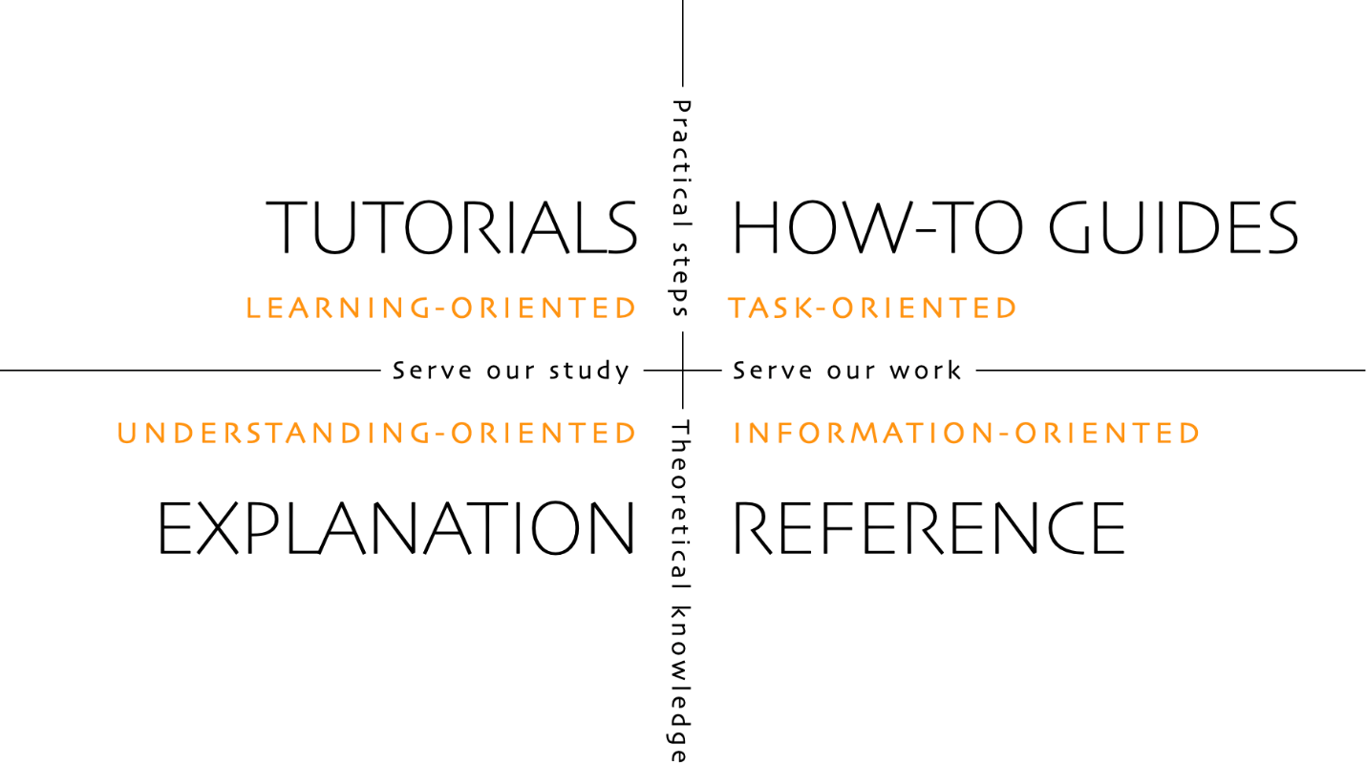
Different Types of Documentation
The Diataxis Framework provides a way to think systematically about how to target different types of documentation
Documents should try to be in just one quadrant! (In practice, often fuzzy)

Slide 16
Different Types of Documentation
The Diataxis Framework provides a way to think systematically about how to target different types of documentation
Documents should try to be in just one quadrant! (In practice, often fuzzy)
Tutorials are lessons that take the reader by the hand through a series of steps to complete a project of some kind. Tutorials are learning-oriented.
How-to guides are directions that take the reader through the steps required to solve a real-world problem. How-to guides are goal-oriented.
Explanation is discussion that clarifies and illuminates a particular topic. Explanation is understanding-oriented.
Reference guides are technical descriptions of the machinery and how to operate it. Reference material is information-oriented.

Slide 17
Characteristics of Documentation in the Diataxis Framework
 | Tutorials | How-to guides | Reference | Explanation
What they do | introduce, educate, lead | guide, demonstrate | state, describe, inform | explain, clarify, discuss
Answers the question | “Can you teach me to…?” | “How do I…?” | “What is…?” | “Why…?”
Oriented to | learning | tasks | information | understanding
Purpose | to allow the newcomer to get started | to show how to solve a specific problem | to describe the machinery | to explain
Form | a lesson | a series of steps | dry description | discursive explanation
Food/cooking analogy | teaching a child how to cook | a recipe in a cookery book | a reference encyclopedia article | an article on culinary social history
Much more discussion at https://diataxis.fr

Slide 18
Tools Can Help with Documentation
Tools can’t write your documentation for you…
But they can help make documentation easier to create and maintain
Templates for content
Extraction, formatting, publication

Slide 19
Documenting Code
Coding standards help make code itself more uniform, more readable, and understandable
Many large organization have (and publish) their coding standards for various languages
Can be used as examples, or adopted wholesale (reduces style-related arguments on your team)
Tools can check and even enforce some standards (often called “linters”)
Other aspects of coding standards aren’t easily automated (e.g., meaningful variable names)
Python: flake8, ruff, black, etc.
C/C++: clang-tidy, clang-format
Fortran: see https://fortranwiki.org/fortran/show/Tools

Slide 20
In-Code Documentation
In-code documentation should focus on the why not the what
The what is right there in the code, and should be self-evident
APIs should be thoughtfully documented in the code
Many tools can help extract API and documentation into standalone documents
The more widely the API is meant to be exposed/used, the better the documentation needed
Thoughtful? Yes, the documentation should be more than a regurgitation of the parameter names used in the API. Document pre-conditions, post-conditions, error conditions, actions, side-effects, show examples of usage, etc.
Tools: Doxygen, NDoc, Visual Expert, Javadoc, EiffelStudio, Sandcastle, ROBODoc, POD, TwinText, and many more…
Typically produce HTML output that can be (automatically) published to a website
Many IDEs offer plugins to help with inline documentation (e.g. templating) for many languages
E.g., VS Code, NetBeans, PyCharm, Eclipse, etc.

Slide 21
Tools for General Documentation and Publishing
Markup languages
E.g., Markdown (MD), ReStructured Text (RST)
Simple text-based markup plus appropriate tools provides reasonable formatting capabilities
Work well with version control
Many free/open source tools available
Formatting/generation tools
Sphinx: started in Python community, but not limited to it. RST or MD inputs. Can output many formats (e.g., HTML, ePUB, LaTeX, …)
Jekyll: static (web)site generation tool. MD input, HTML output. Started as a blogging tool, but much more capable
Publishing (hosting sites)
ReadtheDocs: hosting of Sphinx-based documentation. Free for open-source projects, commercial hosting available. Supports multiple versions.
GitHub Pages: *.github.io URLs, associated with GitHub organizations and repositories. Good support for HTML and Jekyll, others via Actions
Automate where it makes sense

Slide 22

A Look at the Future – MeerCat
MeerCat is a system that supplies tools to support people involved through a Pull Request Assistant (PRA).
The idea of the PRA, and its requirements to be a useful tool, came by working with PR reviewers.
MeerCat attempts to work with the PR author
To diagnose issues with documentation and/or test coverage
To aid in fixing those issues during the PR process.
The goal is a clean, well-thought-out PR that moves its way to formal review.

Slide 23
Context
Before showing MeerCat in action, it helps to know the way it integrates with: (a) GitHub, and (b) the PR process.
Installation of a Webhook (step 2) is optional. Step 3 can be invoked directly from the MeerCat server.
Once step 5 is completed, the PR is ready for formal review.
1
4
Git PR
PR comments including link to MeerCat analysis.
2
MeerCat Analysis of PR files.
PRA Tools
3
5
Notes:
1. Might want to emphasize that MeerCat is not a GitHub app. It is a standalone server that we maintain. I suppose the closest analogy is with CircleCI, which maintains its own testing server.
2. The PRA does require a one-line webhook and ability to join a PR discussion for steps 2 and 4. Otherwise, it is standalone. And even the webhook and discussion ability is optional (steps shown as shaded). A developer can go directly to MeerCat and eventually find the PR, invoke step 3 and commence step 5.
3. Next slide shows steps 1-4 as they play out in a GitHub PR.

Slide 24
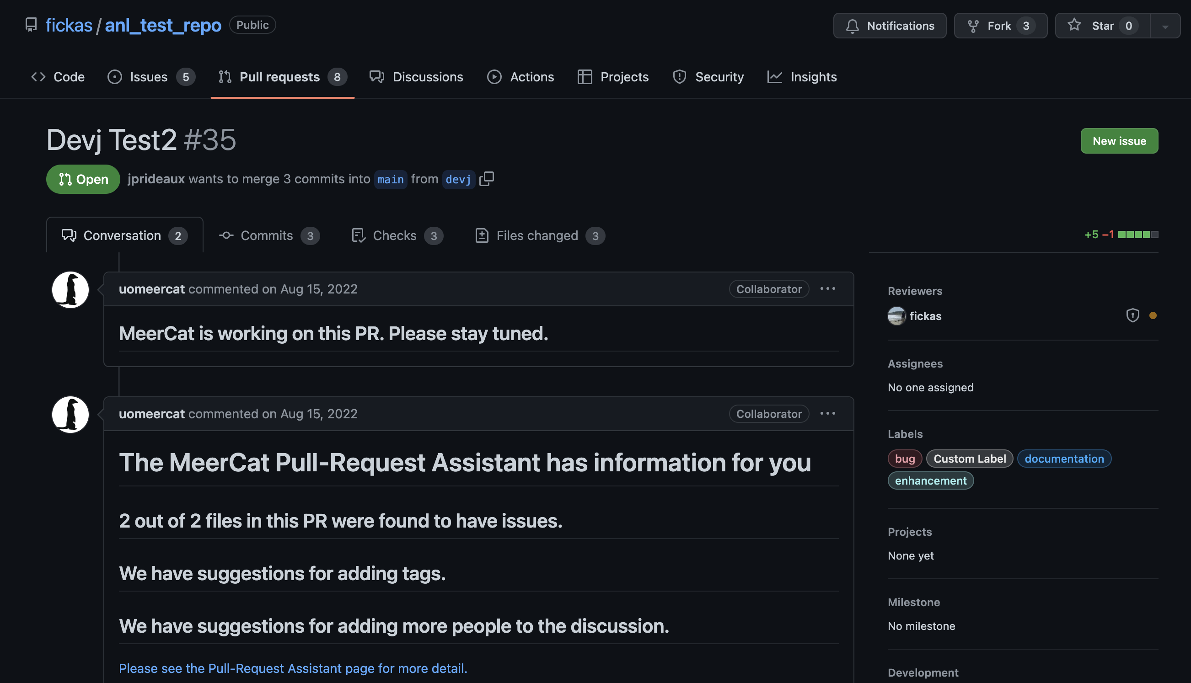
Steps 1 - 4
1
PR created.
2
MeerCat triggered by Webhook.
Analysis carried out on MeerCat server.
3
Brief description of analysis and link to full analysis on MeerCat web site.
4
Notes:
Recent studies note that too many GitHub bots interjecting comments and feedback can be annoying and counter-productive. So we have attempted to keep comments quite brief and have the fuller analysis on our website.
The next slide starts to look step 5, actual interaction between developer and MeerCat.

Slide 25
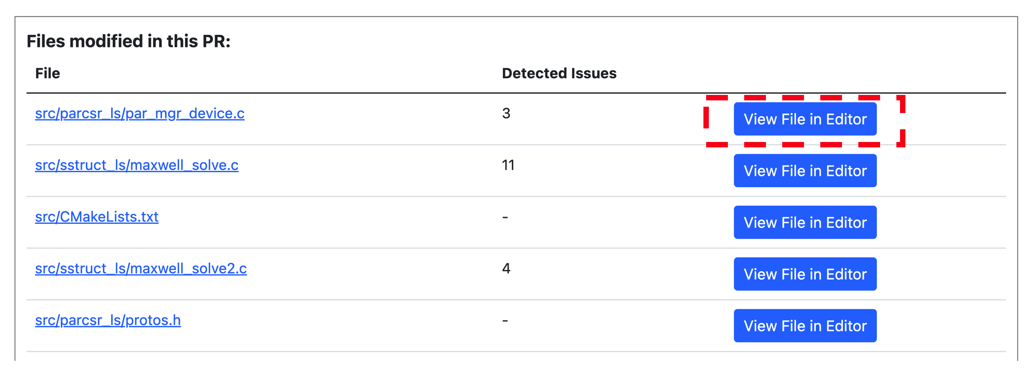
Once on MeerCat, the PRA lists the files in the PR, along with issues. The developer can then invoke the PRA editor to address those issues.

Slide 26
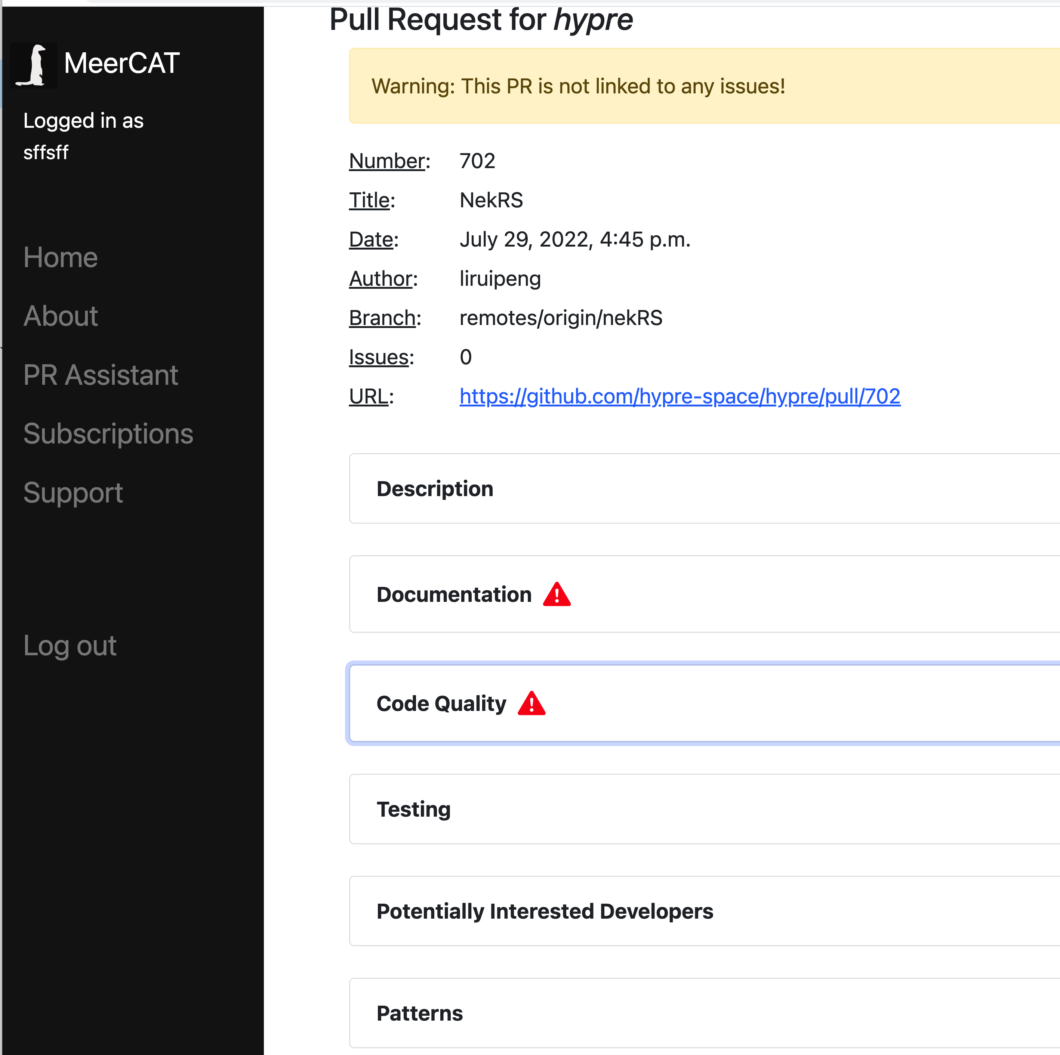
5
Step 5: PRA working with PR author to improve quality before reaching PR reviewer(s).
Currently there is analysis, for each file in the PR, on the following project quality requirements.
Quality of documentation, e.g., correct Doxygen formatting.
Code quality, e.g., linting.
Testing quality, e.g., missing/erroneous unit tests.
Collaboration.
Dangerous development patterns, e.g., churn.
Notes:
This is actual developer interface on MeerCat. They arrive at this page after clicking link in PR comment (step 4 on last slide).
The remaining slides go through each of 5 tabs with examples.

Slide 27
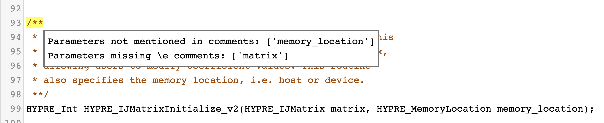
Assistance for: Documentation
Example: the Hypre project requires that developers place Doxygen comments preceding all C++ function declarations. These comments are expected to provide a description of each parameter. MeerCat checks this requirement by parsing the Doxygen comments and comparing against parameter list.
Highlight in yellow.
Popup description.
Notes:
In general, MeerCat can parse function/subroutine signature lines (or interfaces in this case) and make sure all parameters are documented. Example is for Hypre but same holds for Flash-X, etc.
More broadly, it attempts to enforce whatever documentation standards a project has adopted.
At moment, it ignores inline code comments and just focuses on documentation structure, e.g., Doxygen, robodoc, Google docstring, etc.

Slide 28
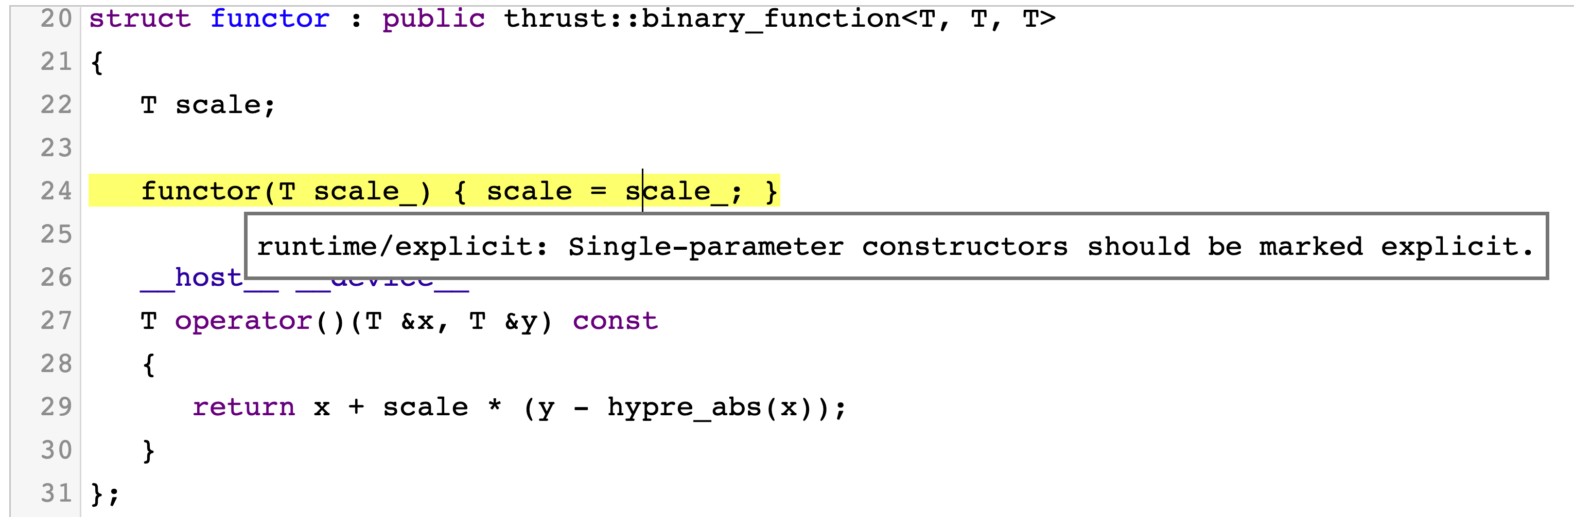
Assistance for: Code Quality
Similar to Documentation, code quality warnings shown in yellow and click to see descriptions.
Notes:
1. Runs open source linters. In this case, <ask Jason>.

Slide 29
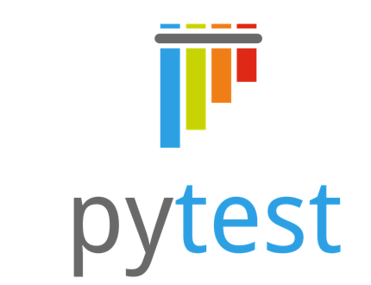
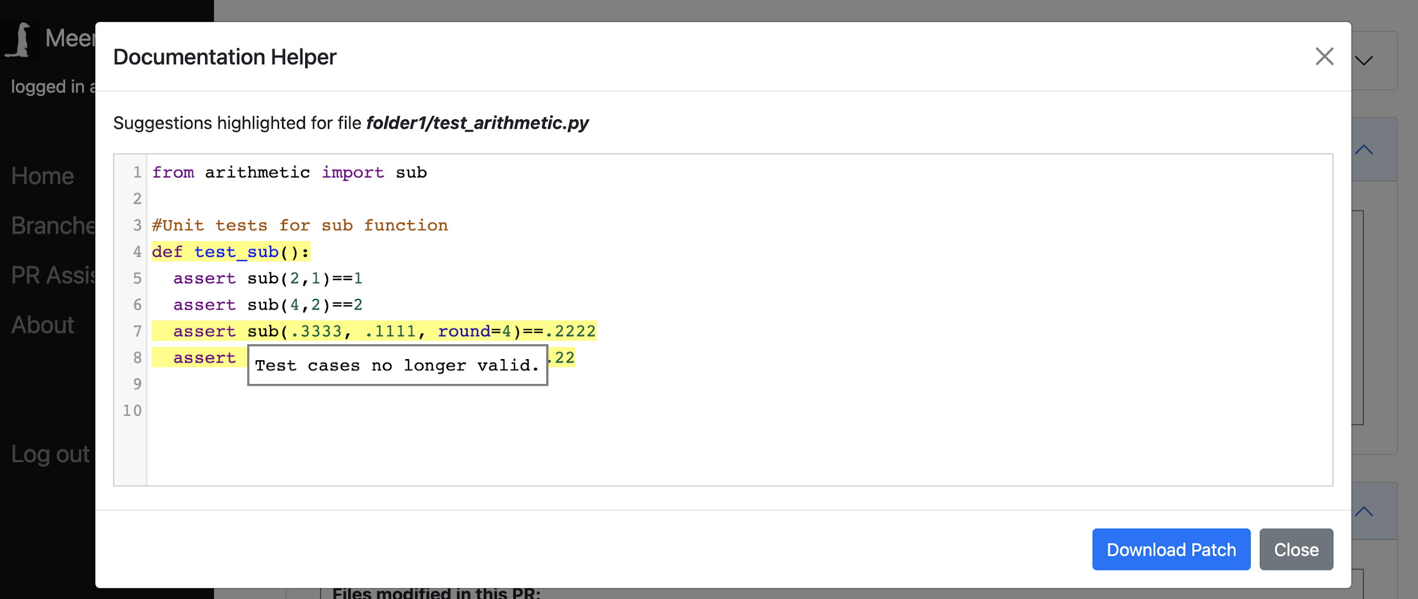
Assistance for: test maintenance
Given a change to a function sub in a code file F, MeerCat searches for test files associated with sub.
Here it finds a test that is no longer valid given the change to sub in the PR.
Caveat: this only works with pytest at the moment, which has a specific structure that can be exploited. GoogleTest is similar.
Many other projects have custom testing structure that require purpose-built search engines, a time-consuming process. Remains a research area for MeerCat.
Notes:
There is also the issue of meta-testing files ala Flash-X, i.e., the taml files that Akash has created to describe a test. These may show up in a PR and need analysis themselves, for correct structure.
This is a future research topic and I use the icon from now on to show more work needs to be done.

Slide 30
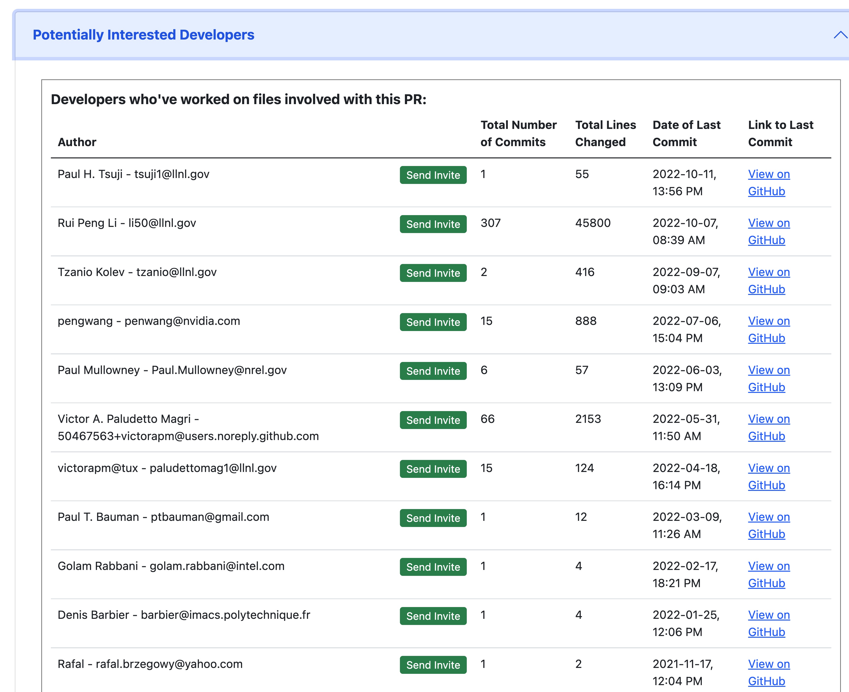
Assistance for: Collaboration
MeerCat finds developers who might have an interest in the PR discussion and provides a means to invite them in.
They can be sent an email-invite to join, which they can accept or ignore.
This is an active area of research for the MeerCat team. We are researching ways to find the “best” candidates. Currently only using past commits to one of PR files.
But now looking at indirect ways a developer might have an interest, e.g., uses a subroutine/function that has been changed, been part of a discussion related to a commit.
Notes:
Note this does not do a mention (e.g., @smith) in GitHub which would then lock the developer into the PR without their consent. So up to invitee whether to join in or not. Trying to keep to principle of being unobtrusive and not annoying people.
This topic will likely be Sam’s thesis, hence the research icon.
Also thinking about how to filter out inactive developers.

Slide 31
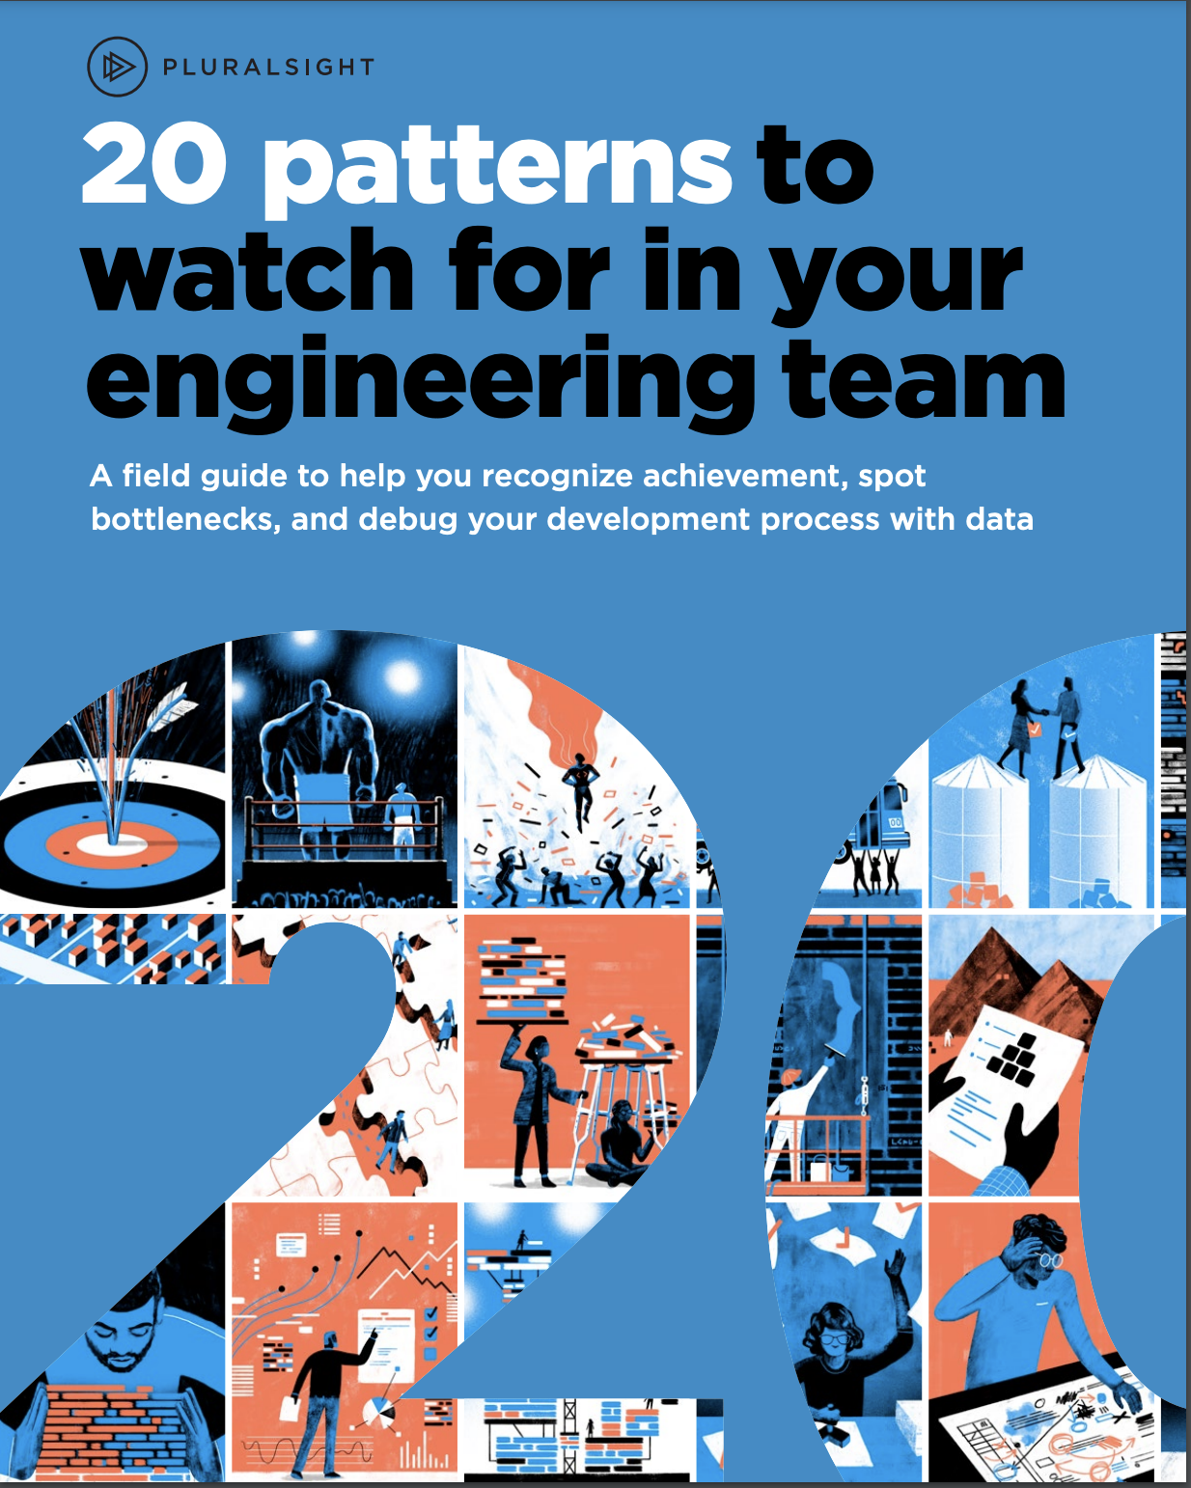
Assistance for: File-level patterns
Churn symptoms: a single developer making (much) above average changes to the same file, often without mooring to an Open Issue.
Churn causes:
Perfectionism: a single developer constantly tweaking code to make it perfect.
Struggling: a single developer rewriting large pieces of code on a routine basis.
Many of these 20 patterns are based on repo-wide analysis. However, several are at the file level and can be checked against the files in the PR.
We describe one in particular: Churn.
Notes:
We are also working on the Bus Factor pattern at the moment (Aliza’s work).

Slide 32
To learn more about MeerCat, and/or using it in your project
Contact fickas@cs.uoregon.edu

Slide 33
Summary
Documentation is valuable to both developers and users (different kinds)
Some of the most valuable documentation for developers has to do with why things are being done a certain way – especially requirements and design decisions that may have been made long ago
It takes work, but should be maintained together with code changes rather than as an afterthought
Think about your target audience when writing documentation
Follow best practices and use appropriate tools to make it easier and more systematic to maintain your documentation

